Slide 1
Lecture 07 - Image Descriptors
Prof. André Gustavo Hochuli
gustavo.hochuli@pucpr.br
aghochuli@ppgia.pucpr.br
Notes:
Prof. André Hochuli

Slide 2
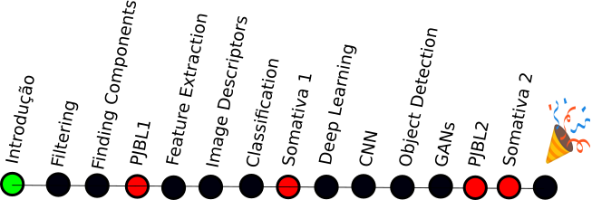
Topics
Discussion of Lecture #06
Feature Vector
Horizontal and Vertical Projections
Image Descriptors
Shape (HoG)
Textures (LBP, GABOR)
Classification
K-NN
Practice
Computer Vision - Prof. André Hochuli
Lecture 07
Notes:
Prof. André Hochuli

Slide 3
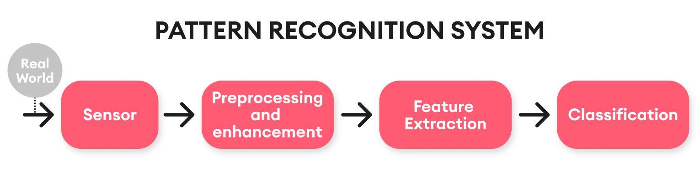
Computer Vision & Pattern Recognition Pipeline
Computer Vision - Prof. André Hochuli
Lecture 07
Notes:
Prof. André Hochuli

Slide 4

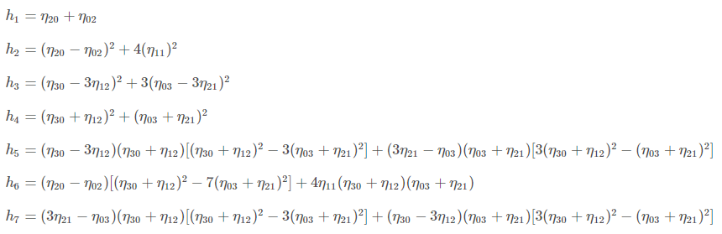
Image Descriptors – Shape
Moments
Values that carry both spatial and intensity information (shape)
Weighted average of all pixel's intensities
I(x,y) ➔ pixel coordinates of input
Powers, p and q, are the weights of the horizontal and vertical dimensions
HuMoments (Hu 1962)
Translation and Scale Invariant
Computer Vision - Prof. André Hochuli
Lecture 07
Notes:
Prof. André Hochuli

Slide 5
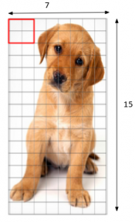
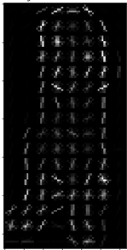
Image Descriptors – Shape
HoG – Histogram of Oriented Gradients
Computes the gradient and orientation of edges
Use a kernel to compute the Gradients (i.e 9x1)
Patch-Based Histogram (8x8, 16x16..)
Computer Vision - Prof. André Hochuli
Lecture 07
Notes:
Prof. André Hochuli

Slide 6
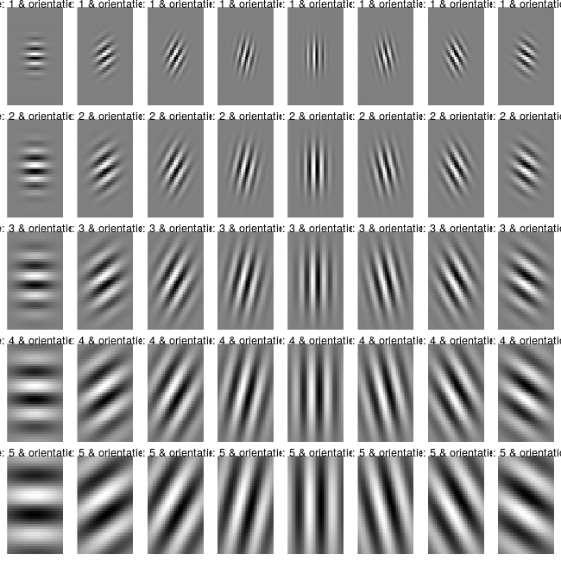
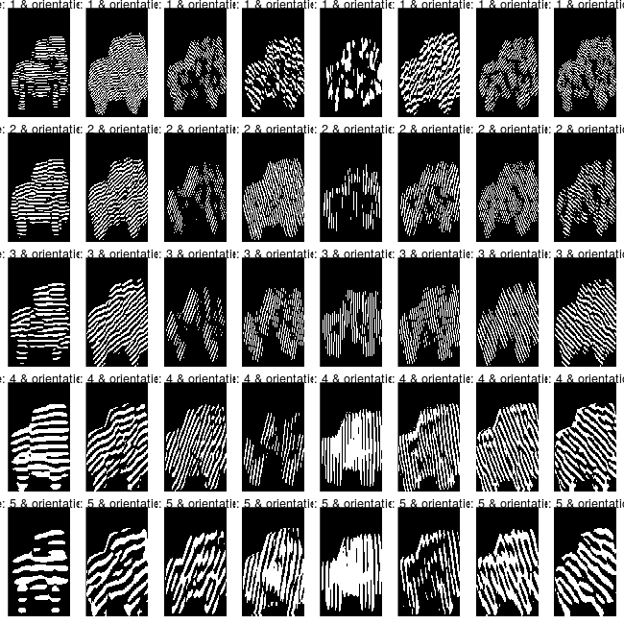
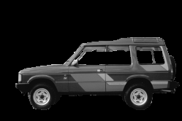
Image Descriptors – Texture
Gabor Filters
Convolves the image using several Gaussian Kernels (Kernel Bank)
Computer Vision - Prof. André Hochuli
Lecture 07
Notes:
Prof. André Hochuli

Slide 7
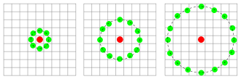
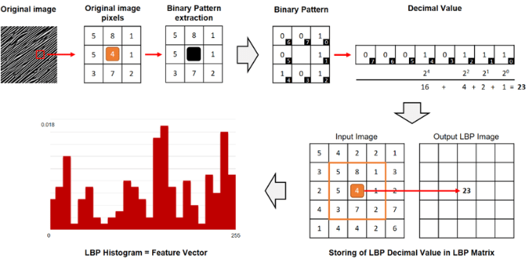
Image Descriptors – Texture
Local Binary Patterns
Convolves the image using a Circular Kernel
The resulting pixel is computed in the binary neighborhood
Computer Vision - Prof. André Hochuli
Lecture 07
Notes:
Prof. André Hochuli

Slide 8
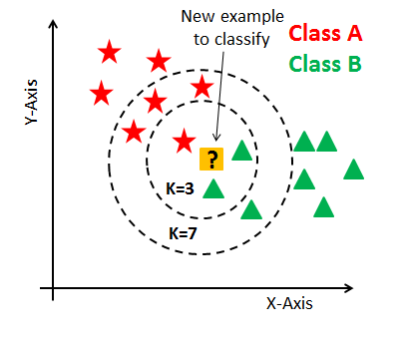
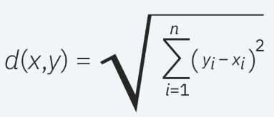
Classification
KNN
Computes the similarity in a feature space (Euclidian Distance, Manhattan….)
The K-Nearest Neighbors determines the class (Majority Vote)
Computer Vision - Prof. André Hochuli
Lecture 07
Notes:
Prof. André Hochuli

Slide 9
Let’s Code
LINK
Computer Vision - Prof. André Hochuli
Lecture 07
Notes:
Prof. André Hochuli

